Slide 1





CSS Transitions and Animations
Beautiful Effects with CSS
CSS Transitions and Animations
SoftUni Team
Technical Trainers
Software University
http://softuni.bg

Slide 2



Table of Contents
CSS Transitions
Delay, duration, property, timing-function
Sugar syntaxes
CSS Animations
Delay, direction, duration
Iteration-count, name, play-state, timing-function

Slide 3

Have a Question?
sli.do #web-basics

Slide 4
CSS Transitions

Slide 5
What is CSS Transition?
CSS transitions animate elements when changing CSS properties
:hover, :focus, :active, :target
Transition syntax:
Transition example:
Required
Required
Optional
Optional
div {
transition: [property][duration][timing-function][delay]
}
div {
transition: width 2s;
}
div:hover {
width: 300px;
}

Slide 6
Problem: Button Transition
.btn {
width: 100px;
height: 50px;
background: rgb(28, 184, 65);
color: white; border-radius: 4px;
transition: all 0.5s linear 0s;
}
.btn:hover {
width: 200px;
height: 100px;
background: #589ffd;
font-size: 25px;
}
<button class="btn">
Button
</button>

Slide 7
Transition Timing Function
Timing function defines how the transitions speed changes over the time (e.g. start fast, end slow)
#div1 {
transition-timing-function:
linear / ease / ease-in / ease-out / ease-in-out
}
.btn {
…
transition: all 2s ease;
}

Slide 8
CSS Transform
Transform: skewX (deg), skewY(deg)
Transform: scale
Transform: rotate
Transform: translate
transform:skewY(20deg);
transform:scaleX(1.2);
transform:rotateX(-20deg);
transform:translateX(30%);

Slide 9
Problem: Kitchens Design
You are given an HTML file + CSS styles (unfinished)
Write the missing CSS transitions

Slide 10
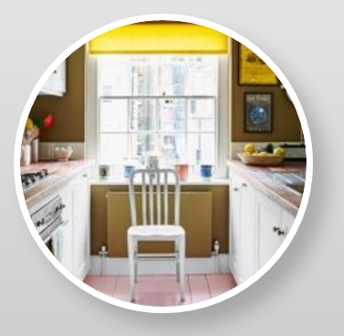

Solution: Kitchen Design CSS (Effect 1)
.effect-1 p {
transition: opacity 0.5s;
}
.effect-1 p:hover {
transition: opacity 0.5s;
opacity: 0.8;
cursor: pointer;
}

Slide 11


Solution: Kitchen Design CSS (Effect 2)
.effect-2 img {
transition: margin-left 1.2s;
}
.effect-2:hover img {
margin-left: 200px;
}
.effect-2 p:hover {
cursor: pointer;
}

Slide 12


Solution: Kitchen Design CSS (Effect 3)
.effect-3 p {
transition:
margin-left 0.7s 0.5s;
}
.effect-3:hover p {
margin-left: 0;
cursor: pointer;
}

Slide 13
Problem: Sport Trainers
You are given an HTML file + CSS
Write the missing CSS transitions

Slide 14



Solution: Sport Trainers CSS
.box {
transition: all 0.7s;
}
.box:hover {
padding-left: 100px;
}
.box:before {
transition: all 0.45s;
}
.box:hover:before {
right: -300px;
}

Slide 15

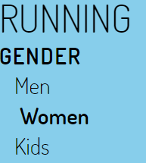
Solution: Sport Trainers CSS (2)
.menu {
transition: all 0.45s;
}
.menu:hover { left: 0; }
ul li a {
transition: all 0.3s;
}
ul li a:hover {
padding-left: 5px;
font-weight: bold;
}

Slide 16
Problem: Church Gallery
You are given an HTML file + CSS styles
Write the missing CSS and CSS transitions

Slide 17
Solution: Church Gallery CSS
body {
background: #ffffff;
font-family:Avenir,Arial,sans-serif;
}
h1{ text-align: center; color:#000;}
#church-container {
background: #ffffff;
overflow: hidden;
position: relative;
width: 80%;
margin: 0 auto;
max-width: 1000px;}
#church-container input[type="radio"] { display:none;}
#church-container label img{
width: 20%;
display: block;
float: left;
clear: left;
border-right:10px solid #111;
}
#church-container label:hover {
cursor: pointer;
}

Slide 18
Solution: Church Gallery CSS
#churches {
width: 90%;
position: relative;
margin-left: 240px;}
#churches figure {
margin: 0;
position: absolute;
opacity: 0;
transform: scale(0.8);
transition: 0.5s all linear;}
#churches figure img {
width: 450px;
border-radius:20px;}
#churches figure figcaption{
position: relative;
background: rgba(0,0,0,.6);
color: #fff;
font-size: 1rem;
padding: 1rem;
margin-top: 1.6rem;
line-height: 1.4;
text-align: left;
}

Slide 19
Solution: Church Gallery CSS
#florence:checked~#churches #florence-fig,
#altenberger:checked~#churches #altenberger-fig,
#saint-michel:checked~#churches #saint-michel-fig,
#moscow:checked~#churches #moscow-fig {
opacity: 1;
transform: scale(1);
}
http://stackoverflow.com/questions/10782054/what-does-the-tilde-squiggle-twiddle-css-selector-mean

Slide 20
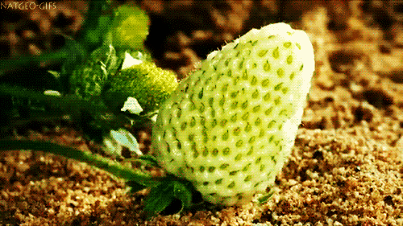
CSS Animations

Slide 21
CSS Animations Syntax
.example {
animation-name: example;
animation-duration: 1.5s; /* or: Xms */
animation-timing-function:ease-out; /*or:ease, ease-in, ease-in-out,linear*/
animation-delay: 0s; /* or: Xms */
animation-direction: alternate; /* or: normal */
animation-iteration-count: infinite;
animation-fill-mode: none; /* or: backwards, both, forwards */
animation-play-state: running;} /* paused, running, running */
Shorthand syntax:
animation: example 1s 2s 3 alternate backwards

Slide 22
CSS Animations Syntax
@keyframes example{
0%{
transform: scale(.3);
background-color: red;
border-radius: 100%;}
50% {
background-color: orange;}
100% {
transform: scale(1.5);
background-color: yellow;}
}

Slide 23
Problem: Scroll Animation
You are given the html file
Write the missing CSS file

Slide 24
Solution: Scroll Animation CSS
body {
font-size: 16px;
font-family:'Open Sans',sans-serif;
font-weight: 400;
background: #efefef;}
strong, b { font-weight: 600;}
h1,h2,h3,h4,h5,h6{font-weight:300;}
i.fa {
color:#333;
}
* {
box-sizing: border-box;
}
.cf:before,
.cf:after {
content: " ";
display: block;
}
.cf:after {
clear: both;
}
.main-container {
background: #fff;
max-width: 1000px;
margin:25px auto 25px auto;
position: relative;
}

Slide 25
Solution: Scroll Animation CSS
.container {
position: relative;
padding: 25px;
}
.animation-element {
opacity: 0;
}
.animation-element.slide-left {
opacity: 0;
transition: all 900ms linear;
transform: translate(-100px,0px);
}
.animation-element.slide-left.in-view {
opacity: 1;
transform: translate(0px, 0px);}
.animation-element.slide-left.testimonial:hover {
position: relative;
transform: scale(1.1,1.1);
z-index: 5;
}

Slide 26
Solution: Scroll Animation CSS
.animation-element.slide-left.testimonial {
float: left;
width: 47%;
margin: 0 1.5% 3% 1.5%;
background: #F5F5F5;
padding: 15px;
box-shadow: 0 1px 1px 0 rgba(0,0,0,0.2);
border: solid 1px #EAEAEA;
}
.animation-element.slide-left.testimonial:nth-of-type(odd){
width: 48.5%;
margin: 0 1.5% 3.0% 0;
}
.animation-element.slide-left.testimonial:nth-of-type(even){
width: 48.5%;
margin: 0 0 3.0% 1.5%;}

Slide 27
Solution: Scroll Animation CSS
.animation-element.slide-left.testimonial .header {
width: 100%;
margin-bottom: 10px;}
.animation-element.slide-left.testimonial .left {
float: left;
margin-right: 15px;
}
.animation-element.slide-left.testimonial .right {
float: left;
}
.animation-element.slide-left.testimonial img {
width: 65px;
height: 65px;
border-radius: 50%;
box-shadow: 0 1px 3px rgba(51, 51,51,0.5);}
.animation-element.slide-left.testimonial .content {
float: left;
width: 100%;
margin-bottom: 10px;
}

Slide 28

Summary
CSS transitions change slowly properties:
CSS animations provide sequence of changes:
div {
transition: all ease 0.5s;
}
div:hover {
width: 200px;
}
animation: circle 1s 2s 3 alternate backwards
@keyframes circle {
0% { transform: scale(.3);
background-color: red;
border-radius: 100%; }

Slide 29








CSS Transitions and Animations
https://softuni.bg/courses/web-fundamentals-html5

Slide 30
License
This course (slides, examples, demos, videos, homework, etc.) is licensed under the "Creative Commons Attribution-NonCommercial-ShareAlike 4.0 International" license

Slide 31




Free Trainings @ Software University
Software University – High-Quality Education, Profession and Job for Software Developers
softuni.bg
Software University Foundation
softuni.org
Software University @ Facebook
facebook.com/SoftwareUniversity
Software University Forums
softuni.bg/forum

